Slide 1
Data Types in SQL Server

Slide 2
SQL Server Data Type
Integer data types
Decimal data types
Money / currency data types
Date and Time data types
Character data types
Binary data types
Special data types

Slide 3
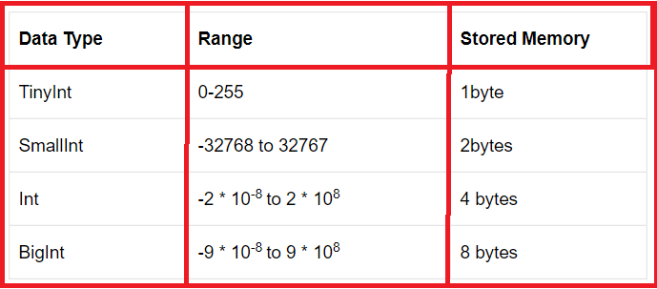
Integer data types

Slide 4
Decimal Data Types
Decimal (P, S)
Numeric (P, S)
Example: 285.21 here the precision is 5
Example: 786.321 Here the scale is 3 as we have three digits that are present at the right side of the decimal point.
Example: 285.21 Scale is 2

Slide 5
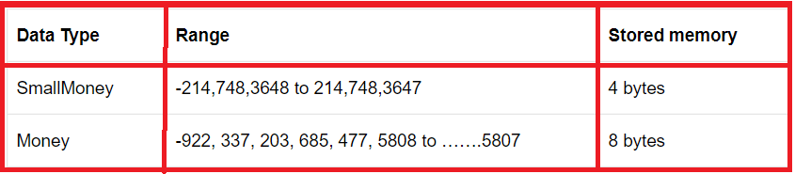
Money / Currency Data Type
These data types are used to accept currency format values into a table column. The money data type again classified into two types.

Slide 6
Date and Time
Date: This data type will accept date format information only. The default format of the date data type is ‘YYYY/MM/DD’
Time: It allows time format information only. The default format of the time data type is ‘hh:mm:ss.ms’
DateTime: It allows date and time format information. The default format of DateTime data type is ‘YYYY/MM/DD hh:mm: ss.ms’.

Slide 7
Character Data Types
Non Unicode data types: char (Size), varchar (size/max), Text
Unicode data types: nchar(size), nvarchar(size), ntext

Slide 8
Char (size):
It is a fixed-length data type (static data type).
It will store the data type in the Non-Unicode mechanism that means it will occupy 1byte for 1 character.
The maximum length of the char data type is from 1 to 8000 bytes.
Disadvantages: memory wastage because size cannot be changed at runtime.

Slide 9
Varchar (size/max):
It is a variable-length data type (dynamic data type) and will store the character in a non-Unicode manner that means it will take 1 byte for 1 character.
The maximum length of the varchar data type is from 1 to 8000 bytes

Slide 10
Text
The text data type is the old version data type of SQL Server and similar to the varchar(max) data type.
Note: The above 3 data types come under the Non-Unicode mechanism and supported to localized data (English culture data only).

Slide 11
nchar(Size) data type:
It is a fixed-length data type and will stores the characters in the Unicode manner that means it will take 2bytes memory per single character.
The maximum length of nchar data type is from up to 4000bytes.

Slide 12
Nvarchar(size/max) data type:
It is a variable-length data type and will store the data type in the Unicode manner that means it will occupy 2bytes of memory per single character.
The maximum length of nvarchar data type is from up to 4000 bytes.

Slide 13
ntext data type:
It is an old version data type of SQL Server and similar to nvarchar(max/size) data type.
Here ‘n’ represents the national.

Slide 14
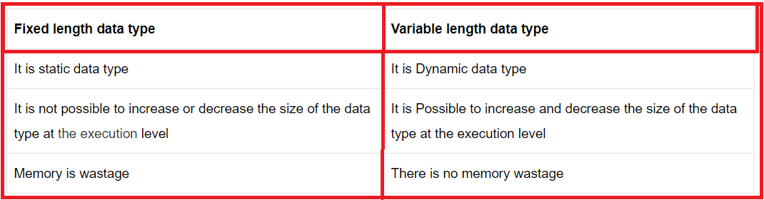
differences between the fixed-length data type and a variable-length data type

Slide 15
Binary data type:
These data types are used to store image files, audio files, and video files into a database location.
Binary data types again classified into three types, such as

Slide 16
Binary(size):
It is a fixed-length data type and will store binary format information (0,1).
The maximum length of the binary data type is from up to 8000 bytes.

Slide 17
Varbinary(size/max):
It is a variable-length data type and will store the information in the form of binary format.
The maximum length of the varbinary data is from up to 8000bytes (we can store 2GB information).

Slide 18
Image data type:
It is an old version data type of SQL Server and similar to the varbinary data type.
Note: Instead of text, ntext and image data type we use varchar(max), nvarchar(max) and varbinary(max) data types in latest versions SQL Server.

Slide 19
Boolean Type:
To hold the Boolean values it provides a bit data type that can take a value of 1, 0, or NULL.
Note: The string values TRUE and FALSE can be converted to bit values. TRUE is converted to 1 and FALSE is converted to 0.

Slide 20
Special data types:
XML data type
Timestamp
Unique identifier

Slide 21
Thank You !!!

